Slide 1
ASA2021 sharing Results – Regional report
Francis Nsanga
November 23, 2022

Slide 2
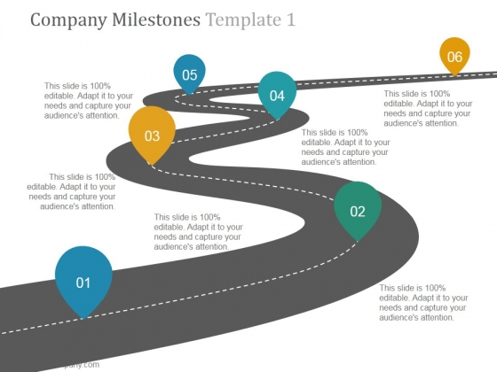
Outline
Introduction
Objective
Methodology
Findings
Discussion

Slide 3
Introduction
The Alcohol Situation Assessment 2021 (ASA2021) was an end line assessment conducted between September and December 2021.
The baseline assessment that was conducted in 2017 preceding the commissioning of the alcohol prevention projects in selected districts/counties/provinces in Uganda, Kenya, Tanzania, Rwanda and Burundi.
With funding from the IOGT-NTO Movement, the ASA 2021 was conducted in 42 parishes/wards/sub counties/ divisions in the five East African countries of Uganda, Kenya, Tanzania, Rwanda and Burundi,

Slide 4
Objective
The main objective of the ASA2021 across the five East African countries was to examine the alcohol use, alcohol effects, alcohol availability and alcohol awareness in the selected parishes/wards/sub counties/divisions/ in the five East African countries of Uganda, Kenya, Tanzania, Rwanda and Burundi.
Specific Objectives:
1. To collect, compile and analyze information on alcohol use, negative effects, availability and awareness which served as a basis to:
a) Ascertain end-line data for the 2017-2021 prevention projects.
b) Obtain more data for advocacy work, locally and regionally.
c) Gather information, inputs and ideas for media coverage.

Slide 5
Approach & Methodology
The ASA2021 largely assumed both cross-sectional study design and a mixed methods approach. Each of the five (5) countries had a Consultant who used the same tools and approach in conducting the ASA2021 assessment.
The assessment employed both quantitative and qualitative methodologies involving administering one-on-one questionnaires, conducting focus group discussions and semi-structured interviews.
The Consultants sought the approval form the relevant authorities for example the Research Ethics Committee (REC) in Uganda. Each of the 5 countries had a Lead Consultant who worked with the partners at country level that identified and trained Research Assistant that conducted the data collection.

Slide 6
Approach & Methodology
Digital tools were highly used because of the COVID-19 restrictions.
The respondents corresponded with the quota sampling requirement, as per the terms of reference, of 15% (488) for under 14 years, 20% (644) for 14-17 years, 30% (952) for 18-24 years, and 35% (1,121) for above 24 years.

Slide 7
Findings_Demographics
These ASA2021 interviewed 3,205 respondents,
Conducted 71 FGDs and 111 Key Informant Interviews from the 42 wards/parishes from the 5 countries.
Country | Total | M | F | <14 | 14 - 17 | 18 - 24 | >24
Uganda | 912 | 459 | 453 | 138 | 184 | 270 | 320
Kenya | 300 | 169 | 131 | 45 | 60 | 90 | 105
Tanzania | 1,200 | 600 | 600 | 176 | 240 | 360 | 424
Rwanda | 150 | 75 | 75 | 22 | 30 | 45 | 53
Burundi | 643 | 318 | 325 | 107 | 130 | 187 | 219
Total | 3,205 | 1,621 | 1,584 | 488 | 644 | 952 | 1,121

Slide 8
Findings_Demographics

Slide 9
Alcohol Use

Slide 10
Ever taken alcohol
Close to half the number of respondents, 47% (1,542 out of 3,205), indicated to have ever taken alcohol before. Up to 53% reported “No”
Burundi has the biggest proportion of 69%, followed by Uganda, 47%; Kenya 43%; Rwanda 42% and Tanzania 33%
In comparison, the baseline reported a higher percentage of 53%, representing a 6% reduction.

Slide 12

Ever taken alcohol
A noticeable reduction in the proportion of respondents who had taken alcohol in the last 12 months was revealed in Tanzania were at baseline, 78% reported to had taken alcohol in the last 12 months, compared to 21% representing a 57% reduction.
In Uganda, 64% reported had taken alcohol in the last 12 months;70% in Burundi; and 72.3% in Rwanda. Altogether, out of all the individuals that had reported to have taken alcohol, 58% revealed that they had taken alcohol in the last 12 months.
“Drunkenness is very common in this community. I no longer take alcohol because there is completely nothing good in it.” 20-year-old female respondent – Walukuba/Masese Jinja.

Slide 13
56.54%!

Slide 14
Age of debut
The ASA2021 results revealed that onset of drinking across the region starts early, below the age of 18 years.
Overall, 56.5% of the respondents started alcohol use before the age of 18 years.
Burundi had the highest proportion of 88.7%! alcohol consumers that started taking alcohol below the age of 18 years.
“I consumed my first beer at the age of 12. After a little time, I could drink up to 10 bottles or a whole locker when with cool friends. It’s dangerous because I once found myself in a man’s bed.” Female respondent from Burundi.

Slide 15
Age of debut
In comparison a slight delay in the debut of alcohol across all countries.
The East African region, majority were introduced to alcohol by friends: In Kenya revealed 83%; Uganda was 46.8%; Tanzania was 31%; and 35.4% for Rwanda.
On the contrary, in Burundi, majority of the respondents, 65.8%, indicated that they were introduced to alcohol by their parents/guardians, down from 81.1% at baseline but still a bit disturbing. Is it a cultural issue?

Slide 16
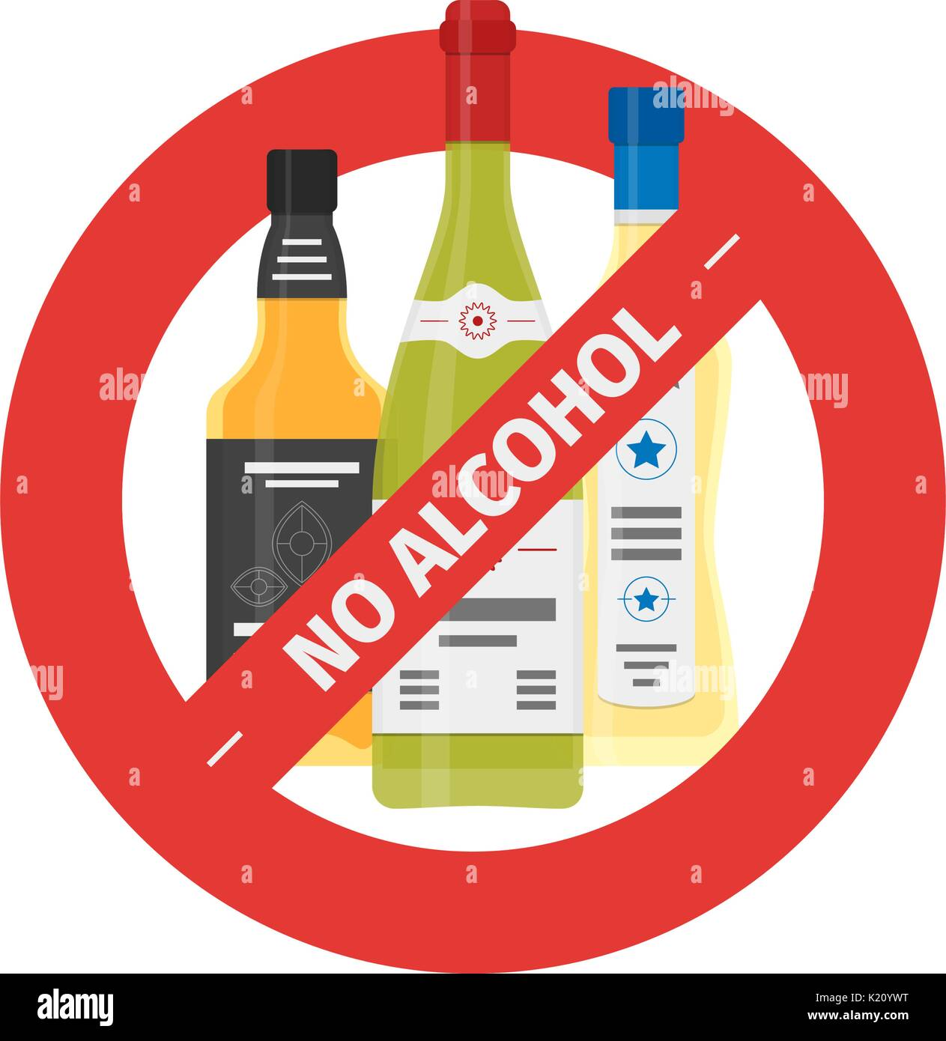
Desire to reduce alcohol consumption
Overall, 70.4% reported the desire to reduce their alcohol use, down from 79% at baseline.

Slide 17
Alcohol Effects

Slide 18
Violated by a man/woman
Across the region, both women and men are affected in terms of violence as a result of alcohol use.
Overall, 34.6% of the respondents from the region reported that they had been violated due to a man or woman using alcohol.
The highest proportion of respondents who reported being violated was from Burundi at 47.3% followed by Uganda 42.3%; then Kenya 28%, Tanzania 21% and Rwanda 20.3%.
In comparison, the baseline had a higher proportion of 41.1% compared to the 34.6% at end line.

Slide 19
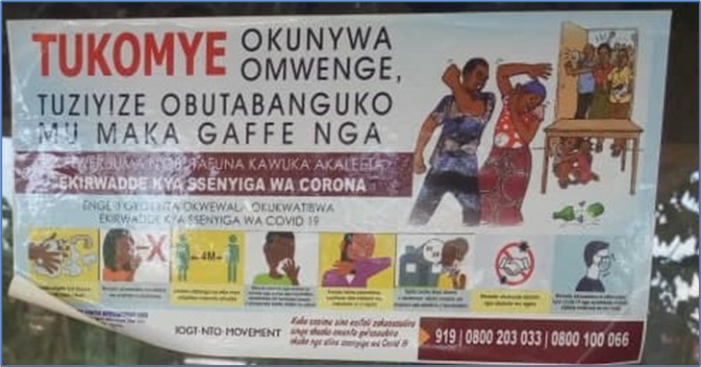
Violated by a man/woman
At country level however, results from some countries showed a reversal trend.
In Uganda for example, the endline results showed an increase in the proportion of respondents that reported being violated from 33.4% in 2017 to 42.3% in 2021.

Slide 20
Beaten by a man/woman

Slide 21
Forced to have sex
A considerable proportion of respondents of up to 18.42% (638 out of 3,205) across the region agreed (strongly agreed and agreed) that they were forced to have sex due to a man or woman using alcohol.
Again, a considerably high percentage of 40.9% was from respondents from Burundi.
It should also be noted that in Burundi, both men (34.9%) and women (46.8%) agreed (strongly agreed and agreed) to being forced to have sex due to a man or women using alcohol.

Slide 22
Forced to have sex
In Uganda, Kenya, Tanzania, and Rwanda, men are equally affected, although the most affected gender in terms of forced sex is the female gender.
Kenya had 22%; Rwanda 14.2%; Uganda 9% & Tanzania 6%.
“I received a phone call from a man inviting me to have a drink with him somewhere. I accepted and he gave me the most alcoholic beverage I have never drunk before. After drinking it, I lost my memory and the man had sex with me and disappeared. I took a pregnancy test by which I found myself pregnant. Then, I gave birth to a little boy who will never know his father.” Respondent from Burundi

Slide 23
Forced to have sex

Slide 24

Abused by Parent/Guardian
Overall, the results showed that abuse by parents/guardians due to using alcohol generally reduced by 6.8% from 39.2% at baseline to 32% at endline.
Conversely, Burundi showed an increase from 73.1% to 75.4%,

Slide 25
Alcohol Availability

Slide 26
Selling Points within 500m
ASA2021 revealed that there is an average of 6 (5.86) alcohol selling points within 500 meters of the areas where the assessment was conducted across in the region.
At country level however, there are more alcohol selling points on average in Burundi (8.3) and Rwanda (8) within 500 meters of the homes of the respondents.
The ASA 2021 also revealed that there is an average of 6 alcohol selling points in Tanzania, 5 in Uganda and 2 in Kenya.

Slide 27
Selling Points within 500m

Slide 28
Producers within 500m
Overall, majority of the respondents 78% reported that they knew an average of 5 alcohol production points in their area, within 500 metres of their residences.
It should be noted that in some locations like Soroti in Uganda and Iringa rural in Tanzania respondents reported up to 10 production points within 500 meters of their residences.
Although in some countries like Tanzania some locally produced liquor is regulated, in most countries, locally produced alcohol is informal and unregulated.

Slide 29
Ease of Access
On average, 80% of the respondents from the region agreed (strongly agreed and agreed) that it was easy for them to access alcohol as and when they wanted.
The country with the easiest access to alcohol was Kenya where 90% of the respondents agreed, followed by Uganda with 87%; Rwanda 85%; Burundi 71%; and Tanzania 65%.
Clearly, as much as all the five countries observe that alcohol should not be sold or taken by anyone under the age of 18 years, teenagers have easy access to alcohol in many places across the East African region.

Slide 30
Ease of Access

Slide 31
Bought home-made alcohol
Overall, there was a reduction in the respondents across the region who agreed (strongly agreed and agreed) to having bought homemade alcohol in the last 6 months from 37.5% at baseline to 17% at endline.
At country level, purchase of homemade alcohol was observed to be highest in Soroti (33%) for Uganda and Iringa Rural (26.3%) for Tanzania. These two areas also stand out to be the highest in the region, where ease of access to alcohol is highest.
Up to 49% who reported having bought homemade alcohol where under 18 years of age. Only 26.4% were aged 25 years and above.

Slide 32
Asked to buy alcohol by parent / guardian
Overall, 30.9% agreed (strongly agreed and agreed) that they had been asked to buy alcohol by a parent/guardian, across the region.
Out of those who reported that they had been asked by a parent or guardian to buy alcohol, 22% (regional average) were below the age of 18 years.
The findings at endline (30.9%) are almost consistent with the percentage at baseline of 30.3%, depicting no major shift in the behaviour of parents/guardians asking children to buy alcohol. Exposing minors to alcohol is still a challenge.

Slide 33
Alcohol Awareness

Slide 34
Consider alcohol as a social drink
Overall, out of the 3,205 respondents from the 5 countries, 42.9% considered alcohol as a social drink, while 57.1% did not.
The older the individual the most likely they considered alcohol a social drink.
Below 14 years accounted for 18.7%; 14-17 yrs -17.5%;18-24 yrs - 30.9% and above 24 yrs -42.9%.
“Generally, the authorities haven't done much about alcohol abuse. They view alcohol use as a right. In addition, the community looks at alcohol consumption and abuse as a normal everyday activity. It is generally acceptable.”
Female Teacher from Bugembe in Jinja district

Slide 35
Knowledge of negative effects
Out of the 3,205 respondents reached, 83.79% reported having knowledge of the negative effects of alcohol.
Burundi had 98%, highest in the region.
Similarly, Uganda and Tanzania had high proportions of respondents that reported having knowledge of negative effects of alcohol accounting for 94.5% and 92.6% respectively.
Kenya had 81.5% and Rwanda had the least percentage of 50%.

Slide 36
Knowledge of negative effects

Slide 37
Knowledge of restrictions
Out of the 3,205 respondents reached, 66.44% reported having knowledge of restrictions on alcohol.
Consistent with the baseline findings, Kenya had the highest proportion of 99.9%, followed by Rwanda at 91% of the respondents who reported knowledge of government restrictions on alcohol at endline.
In comparison, there is an observable improvement in the knowledge of restrictions across countries from an average of 53.8% baseline to 66.44% at endline.

Slide 38
Knowledge of restrictions

Slide 39
Conclusion
Reduction is visible but slow! Alcohol use and alcohol related harm remains an important social challenge in the East African region.
The ASA 2021 revealed that alcohol is readily available in the communities where data collection was conducted, across the 5 East Africa countries.
The use of alcohol still remains high in the communities surveyed, although slightly lower than the reported rate in the baseline report.
There are promising results from some parameters surveyed due to awareness creation especially on the negative effects, delayed debut of alcohol intake and reduced violence, especially reduction in forced sex due use of alcohol.
There are parameters like number of selling points and production points that reduced in a few places but potentially growing in other places since the baseline.

Slide 40
Recommendations
There are a number of recommendations for the different stakeholders including IOGT-NTO, UAPA, civil society, the central and local governments, and the community.
IOGT-NTO Movement
TheThe IOGT-NTO Movement should consider continuing to supporting civil society organizations to scale-up the implementation of interventions in East Africa.
The ASA2021 was conducted at a time of great disruption caused by the COVID-19 pandemic. There is a strong likelihood that different trends emerged and lifestyles changed due to the pandemic. A study taking into the context may be warranted.

Slide 41
Recommendations
Civil Society Organizations:
The IOGT- NTO Partner Organizations across the East African region should consider strengthening the network using innovative approaches that involve other sectors in addressing the policy gaps on alcohol control in their countries.
There is need to continue cultivating cordial working relationships with other sectors and partners especially the government ministries departments and agencies, technocrats, legislators, among other key partners.
The IOGT- NTO Partner Organizations across the East African region should also consider / continue advocacy approaches that attract international players and partners into their countries.

Slide 42
Recommendations
National and Local Government Leadership
The local government leaders should consider strengthening their working relationship with the civil society organisations in the East African region.
Encourage and support sharing knowledge on effective policies and strategies for the promotion of ordinances is also critical to increase their effectiveness.
Reducing alcohol related harm will require a multisectoral approach. When critical “gatekeepers” in the value chain are ignorant, complacent, and ineffective, efforts towards the reduction of alcohol harm will be futile on the onset.
Embrace and support promising interventions like the SAFER Initiative, with proven evidence-based, low cost and high impact strategies.

Slide 43
Recommendations
The Community
Commitment and vigilance at community level will be key in addressing the onset of alcohol use and thereby prevent alcohol related harm. Parents, guardians, elders and opinion leaders across the East African region need to take their positions and responsibilities as community gatekeepers. They should be empowered with the required skills.
There should be more restrictions of sale of alcohol to persons under 18 years and more community led prevention messaging initiatives. Promotion, sensitization and adherence to local ordinances should be enforced by the community to achieve utmost impact.
There should be a more intentional approach at community level to sensitize citizens on dangers of alcohol use and popularisation of local alcohol prevention ordinances at community level.

Slide 44
Challenges
The COVID-19 pandemic:
travel restrictions,
social distancing ,
emotional stress among respondents, among other issues
The delays in granting approval and authorisation to conduct the assessment impacted on the delivery time. This was addressed by seeking additional time to be able to complete the assignment successfully.

Slide 45
Vote of thanks
To IOGT-NTO
The research team
Ministry of Healthy
The Consultants in each of the 5 countries
The REC
The Partner Organisations:
UAPA
UNACOH
UGGA
UYDEL

Slide 46


Slide 47
Thank you!

